Slide 1



Classification
Supervised Learning : Klasifikasi
Nama Pengajar
Dian Ade Kurnia, M.Kom
Rusnanda Farhan
Rusnandi Fikri
Rika Sahriana

Slide 2

Outline
Introduction Machine Learning
Introduction Classification
K Nearest Neighbor
Decision Tree
SVM

Slide 3
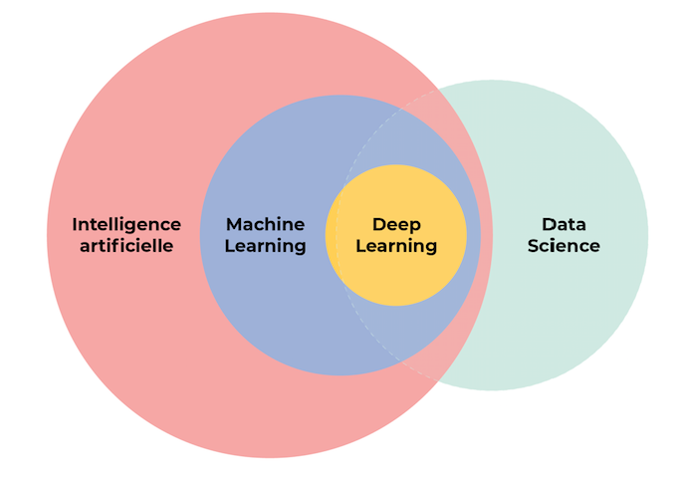
Introduction Machine Learning
Machine Learning is part of Artificial Intelligence, and intersects with Data Science. Machine Learning is the study of computer algorithms that can improve automatically through experience and by the use of data (training data). As the result of Machine Learning. it usually builds/produces a model.

Slide 4
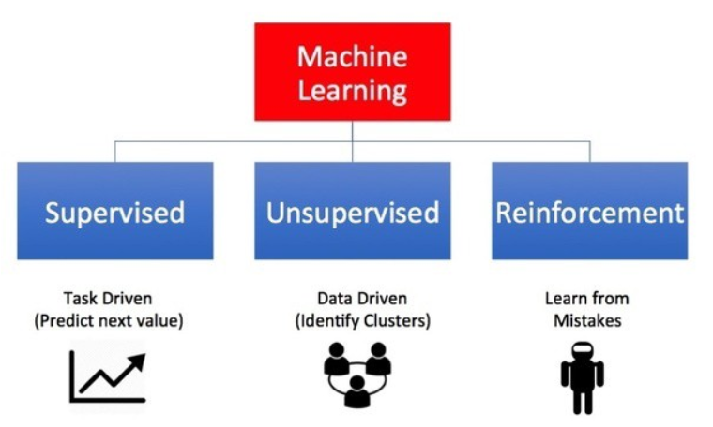
Kind of Machine Learning

Slide 5

Introduction Classification
Classification. A data science task that predicting predictors or attributes (numerical and/or categorical variables) into the value of a categorical variable (usually called target or class).

Slide 6
Kind of Classification
BINARY CLASSIFICATION
Binary Classification is a classification task that have to predict one of two classes provided
MULTI-CLASS CLASSIFICATION
Multi-Class Classification is a classification task that have to predict one of many classes provided (more than 2 classes)
MULTI-LABEL CLASSIFICATION
Multi-Label Classification is a classification task that could predict more than one class from many classes provided

Slide 7
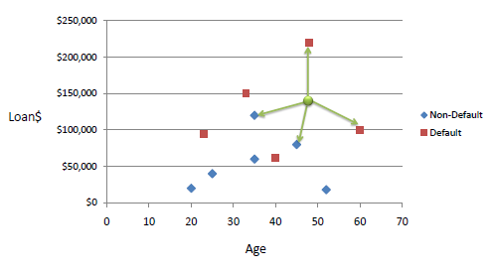
K Nearest Neighbor
K nearest neighbors is a simple algorithm in classification task based on a similarity measure (e.g., distance functions). This algorithm believes that if the instances have similar predictor, so they will be in the same class.

Slide 8
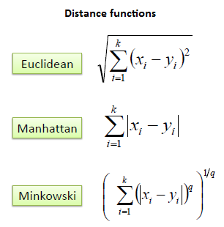
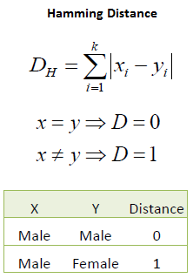
K Nearest Neighbor
Continuous Values
Categorical Values

Slide 9
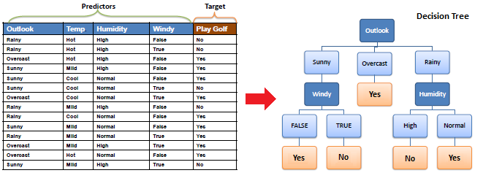
Decision Tree
Decision tree is an algorithm that build a model based on a form of a tree structure.

Slide 10

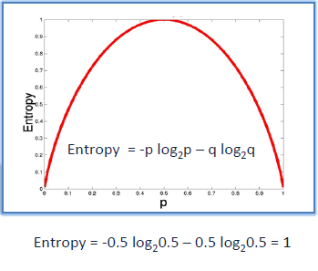
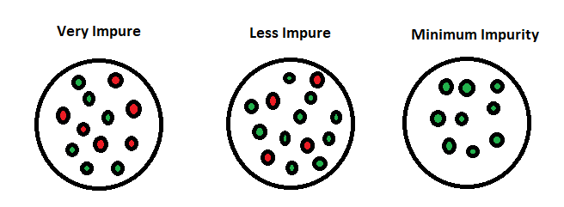
Decision Tree
Entropy is an information theory metric that measures the impurity or uncertainty in a group of observations. It determines how a decision tree chooses to split data.

Slide 11
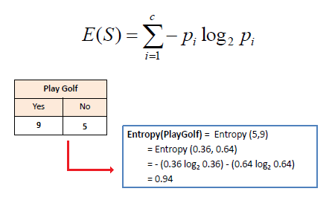
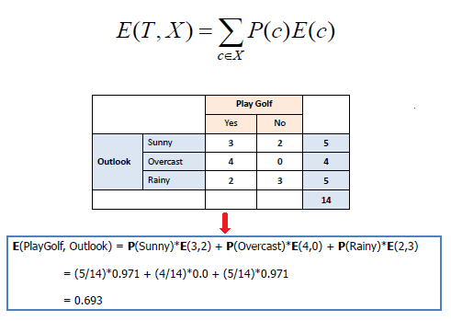
Decision Tree

Slide 12
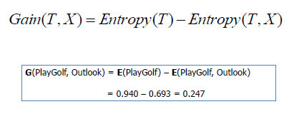
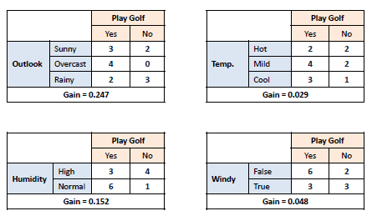
Decision Tree
Information Gain
We can define information gain as a measure of how much information a feature provides about a class. Information gain helps to determine the order of attributes in the nodes of a decision tree.

Slide 13
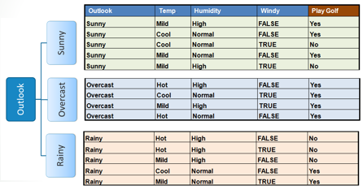
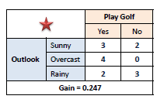
Decision Tree

Slide 14
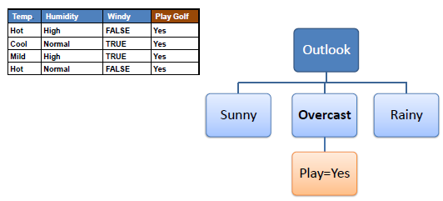
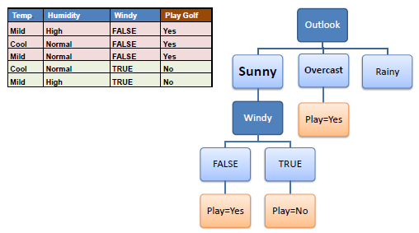
Decision Tree
Entropy =0
Entropy >0

Slide 15
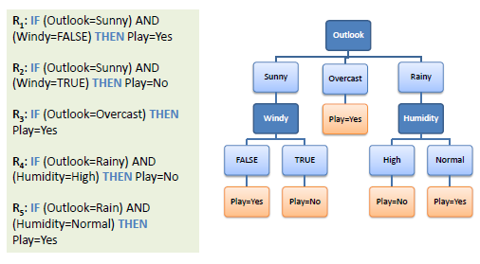
Decision Tree

Slide 16
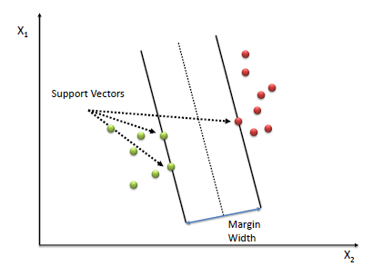
Support Vector Machine
Support Vector Machine (SVM) is an algorithm in classification task that perform by finding the hyperplane that maximizes the margin between the two classes. The vectors that define the hyperplane are called the support vectors.

Slide 17
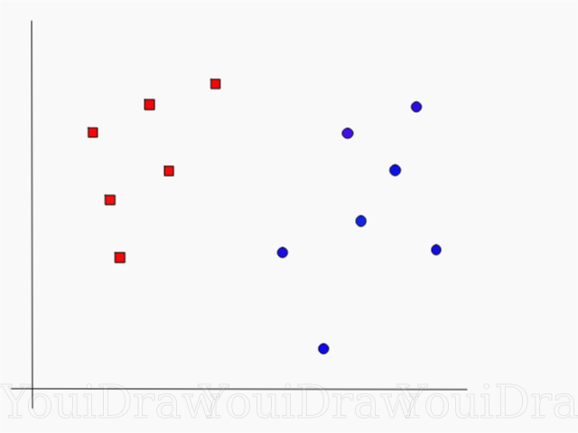
Support Vector Machine
Support Vector Machine (SVM) is an algorithm in classification task that perform by finding the hyperplane.
What is hyperplane? To know the answer, let’s take a look the example on the right side. The dataset contains 2 class, let’s say red and blue

Slide 18
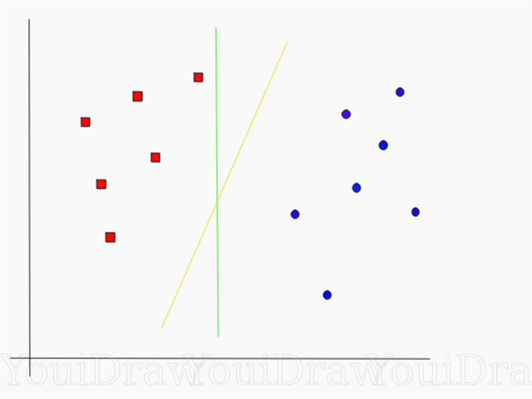
Support Vector Machine
Data Point
SVM will draw the separator-line that can separate these two classes. The problem is we have to choose one from millions line. This best separator-line called hyperplane.
To draw hyperplane, we have to choose two instances/data points that closest to hyperplane candidates from both classes. These data points called support vectors.
Data Point

Slide 19
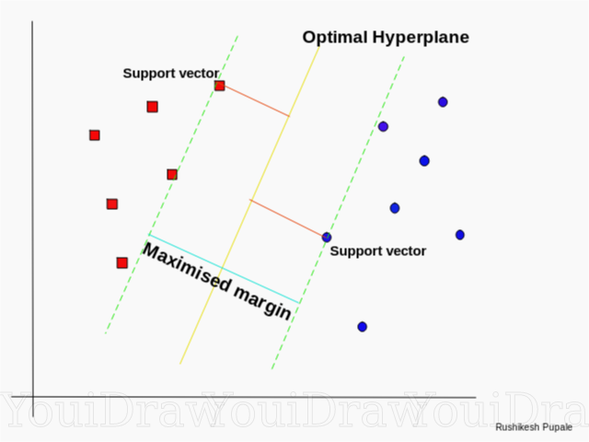
Support Vector Machine
Compute the distance between the candidate line to each support vectors. The distance called margin.
The best hyperplane is the line with maximum margin.

Slide 20
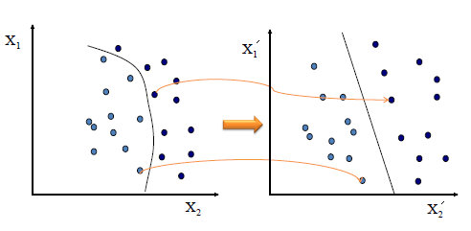
Support Vector Machine
1
Some advance problems in SVM

Slide 21
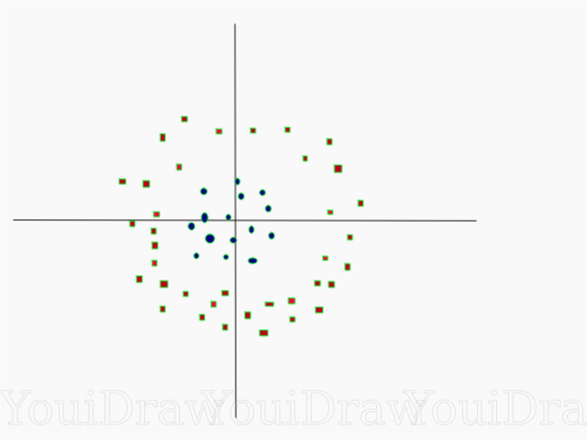
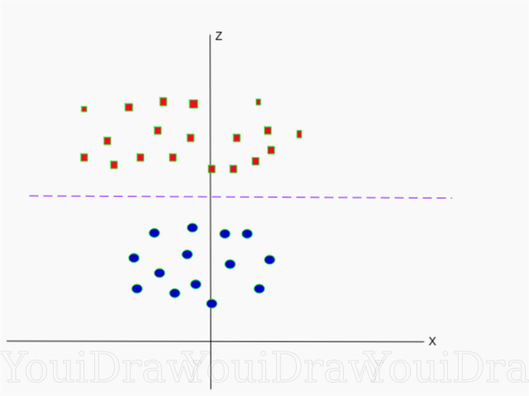
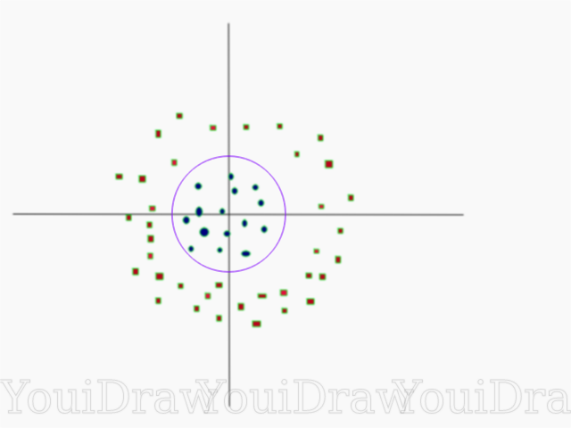
Support Vector Machine
2
Some advance problems in SVM

Slide 22
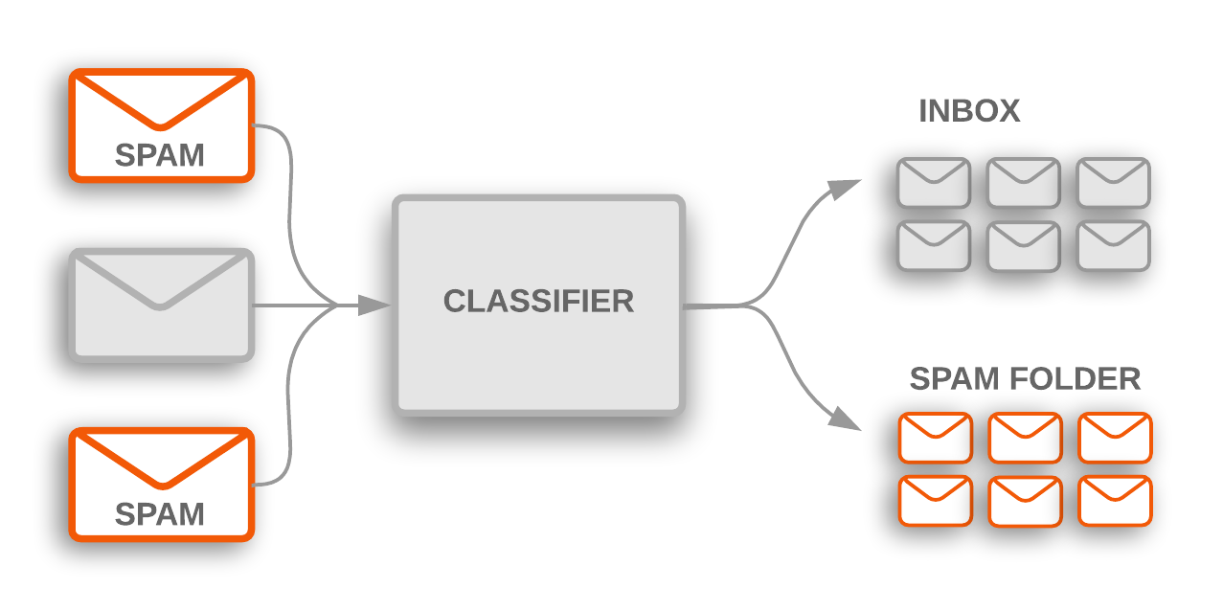
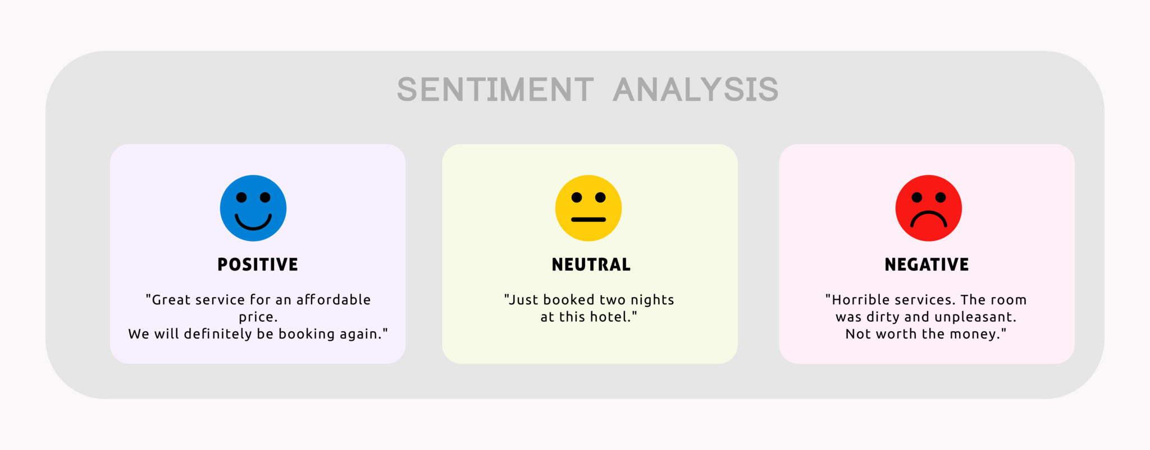
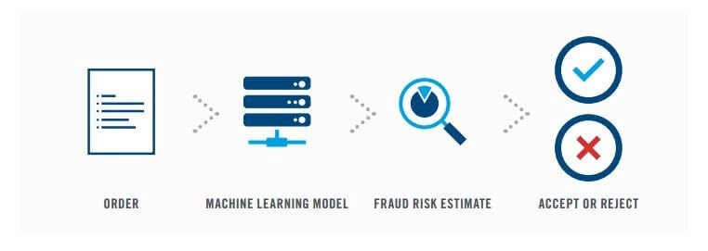
Real Cases in Classification Task
Spam Email Classification
Sentiment Analysis
Fraud Detection

Slide 23

Summary
With Machine Learning we can build models that are very important in an intelligent system or AI
Classification as part of Machine Learning aims to perform the ability that can classify the data into a defined class.
In industrial cases, classification not only can be used in tabular data but also can be used for unstructured data such as text data, images, etc.

Slide 24
References
https://www.saedsayad.com/
https://towardsdatascience.com/
https://en.wikipedia.org/wiki/Machine_learning

